Slide 1
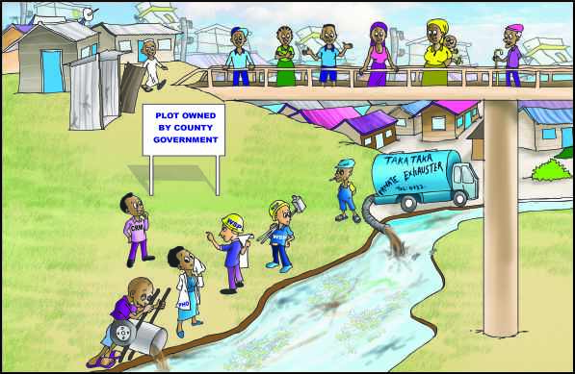
Water Services Trust Fund
DTF Site Selection and Design Adaptation
Workflow and Stakeholders

Slide 2
Content
Introduction
Project Initiation
Awareness Meeting
Feedback Meeting
DTF introduction, Site Selection and Surveying Training
Site Selection and Surveying
Site Approval
Detailed Site Surveying
DTF Design Adaptation Training

Slide 3
Introduction
DTF is intended to enhance public health conditions in low income urban areas
DTF is intended to close the sanitation value chain by treating the human waste generated in low income areas (also the UDDT matter)
Most neglected and most important component of the sanitation value chain
Purpose of the presentation
Understand the different stakeholders that are relevant in the site selection and design adaptation workflow stages

Slide 4
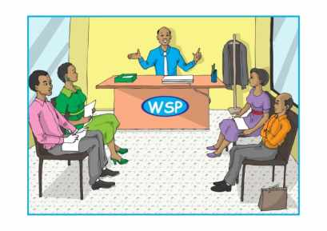
Step 1: Project Initiation
Set up of the WSP internal DTF Technical Team
Set up of a WSP internal “DTF technical team” within the company comprising of staff with the required mix of competencies by the MD
If required, external consultants e.g. surveyors are incorporated in the DTF technical team
Establish a close collaboration with required external stakeholders
Tools required: Site selection and surveying
Stakeholders: MD, WSP DTF technical team

Slide 5
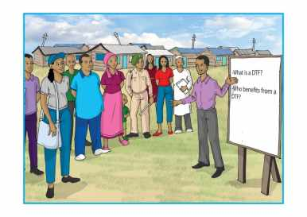
Step 2: Awareness Meeting
DTF Technical Team in collaboration with the Pro-Poor unit (Sanitation Department) initiates identification of LIA that requires a DTF
Pro-Poor unit together with DTF technical team consults with local key stakeholders about their perception of having a DTF in their vicinity as well as identifying potential locations
Stakeholders: Pro-Poor unit, DTF technical team, Area Chief, Elders, Residents, PHO, NEMA and WRMA

Slide 6
Step 3: Feedback Meeting
Pro-Poor unit and DTF technical team present the opinions of the residents of the targeted LIAs regarding having a DTF and proposed potential sites to the WSP top management
Stakeholders: Pro-Poor unit, DTF Technical Team, Managing Director, Technical Manager, Financial Manager, Commercial Manager

Slide 7
Step 4: DTF Introduction, Site Selection and Surveying Training
WSTF trains DTF technical team on DTF introduction and Site Selection Surveying
Tools required: “DTF introduction” and “Site Selection and Site Surveying”
Stakeholders: DTF technical team and WSTF

Slide 8
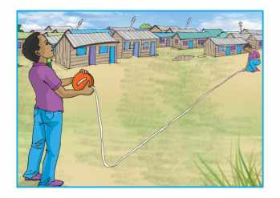
Step 5: Site Selection and Surveying
DTF Technical Team selects site by using the site selection and surveying tool in collaboration with required stakeholders
EIA is carried put by a registered environmental expert. Once approval is provided by NEMA, the selected site including the filled decision matrix is presented to the MD of the WSP
Tools required: Site selection and Surveying
Stakeholders: CRMs, PHO, NEMA, WRMA, WSTF Flying squad (on demand)

Slide 9
Step 6: Site Approval
The WSP analyses the site selection results. MD confirms results and forwards the proposal to the WSTF
The WSTF checks proposal including the DTF site selection analysis report, target group and then gives no objection
Tools required: Site Selection and surveying (signed decision matrix)
Stakeholders: MD, WSTF

Slide 10
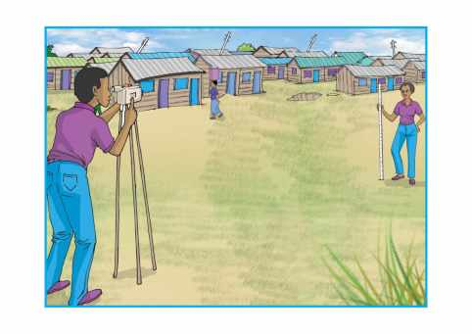
Step 7: Detailed Site Surveying
If required, DTF technical team gather more details on site characteristics (baseline data for design adaptation)
Tools required: Site Selection and surveying
Stakeholders: DTF technical team and flying squad (on request)

Slide 11
Step 8: DTF Design Adaptation Training
DTF technical team attends design adaptation training equipped with detailed baseline data
WSTF coaches DTF technical team on adaptation of technical drawings and Bill of Quantities (BoQ’s) to come up with a detailed design based on local conditions
Tools required: Generic technical drawings and BoQ’s
Stakeholders: DTF technical team and WSTF

Slide 12
Any further stakeholders?
Poster discussion in groups (10 mins)
Identification of further stakeholders that could be involved in the workflow

